Slide 1
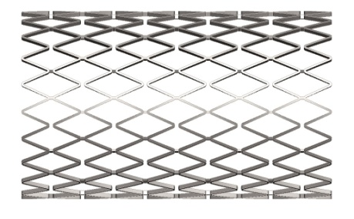
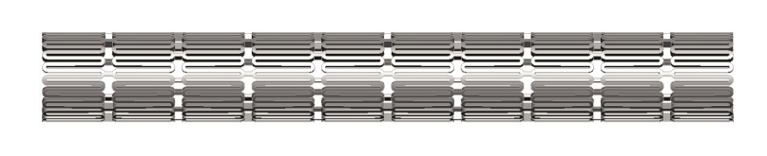
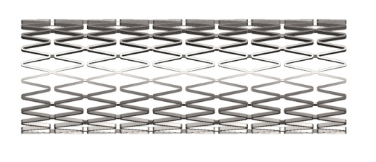
Pro/Engineer CAD model for the Open Stent project prepared by: Erik Smith of Teckna Inc. http://www.teckna3d.com
All data used to develop the work shown here was provided by NDC’s Open Stent website. Please follow the link below for more information about the open stent project as well as an extensive amount of technical information on the design, materials & manufacture of medical stents:
http://www.nitinol.com/nitinol-university/open-stent-design/introducing-open-stent-design
I would like to express my sincere gratitude to Mr. Craig Bonsignore of NDC Corporation for providing this information and his encouragement of my efforts to develop this model. I hope it can be of some use to the Open Stent project and in the Pro/Engineer circles of medical device development.

Slide 2
Model Information and Disclaimer (my apologies for all of the fine print)
This PowerPoint file is designed to be a guide to familiarize the user with the Pro/Engineer model included as part of the Open Stent Project. It should be noted that NDC has previously created a Solid Works model as well as an Excel spreadsheet to calculate many of the dimensions and properties of the Open Stent Model. The model shown here is designed to be a stand alone CAD model demonstrating an alternate methodology for creating the Open Stent Design solid model shape using the Pro/Engineer CAD system. It is also limited in that no attempt was made to include material values, this is left to the user. Also the model does not include the effects of any particular Stress-Strain curve on the deflected shape of the stent. The model is a parameterized geometric solid reflecting a crimped state and any number of deployed shapes between the diameters of 1.916 to 8.00 mm.
The Pro/Engineer model should be used in conjunction with the configuration file (stent_config.pro) and layer configuration file (proe_open_stent_layer_file.pro) included as downloadable files from the same website. The Pro/Engineer file should be opened in its own directory which includes the configuration file. Also no attempt to use this model with Windchill or any other PTC product has been made. Lastly there is no guarantee of fitness of this CAD model for any purpose other than to generate appropriate solid model geometry within the context of the Open Stent Project. The data is free to use without restriction except as is stated on the Open Stent Design website as previously noted. Otherwise please use this CAD model and feel free to modify and improve it.
Erik Smith/Teckna Incorporated
On the web at http://www.teckna3d.com

Slide 3
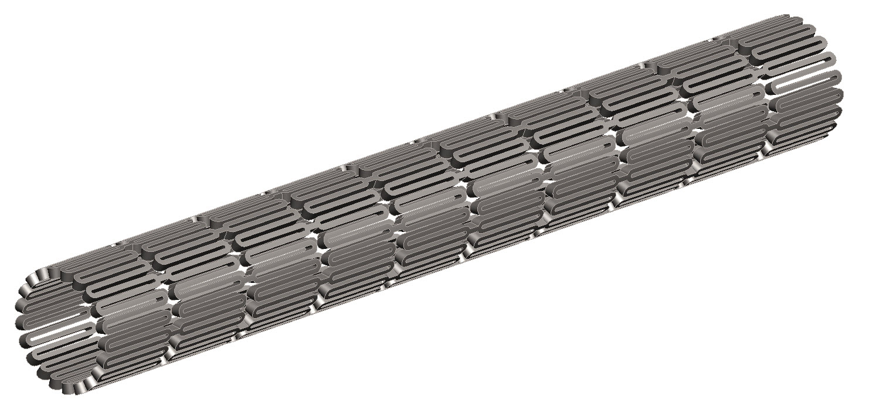
Introduction
Step 1 - load part and configuration files
Part file: open_stent_proe.prt
Configuration file: stent_config.pro
Layer file: proe_open_stent_layer_file.pro
You should see a model that looks something like this.
Also note I use a black background and a Pre-Wildfire color scheme

Slide 4
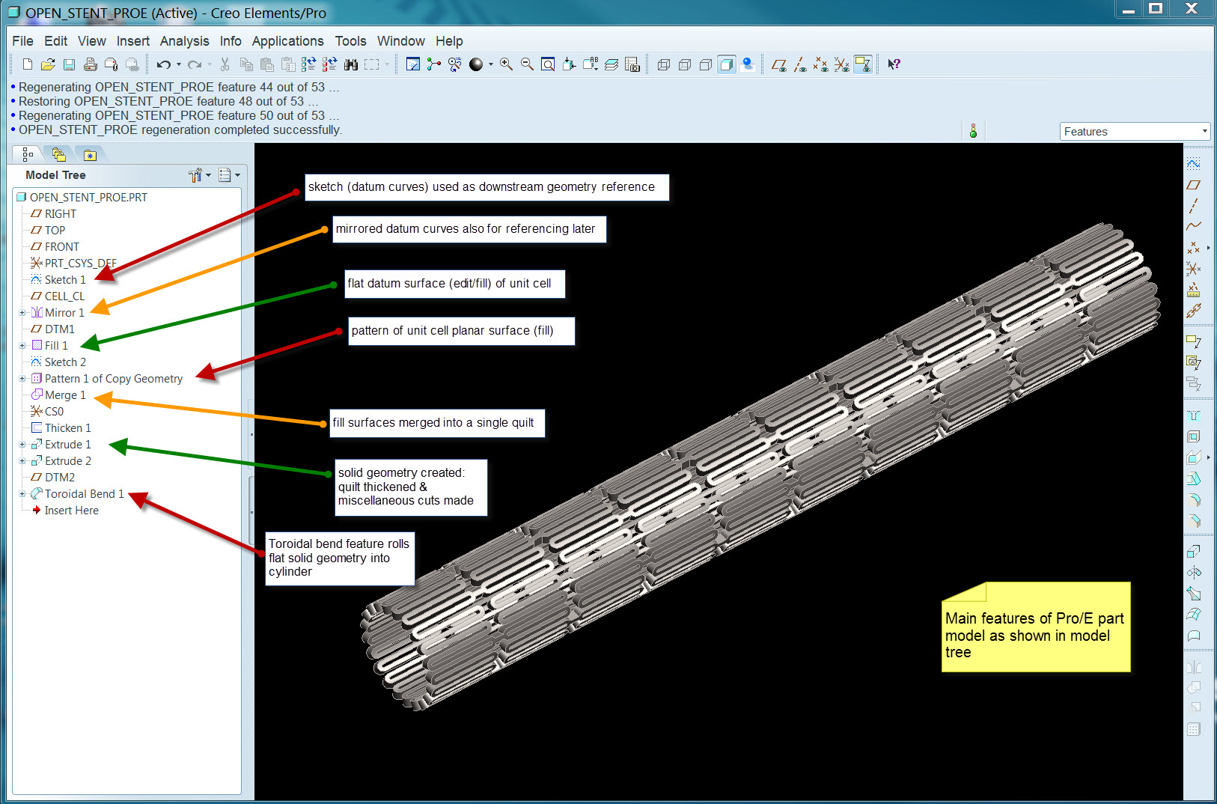
Modeling Procedure Overview

Slide 5
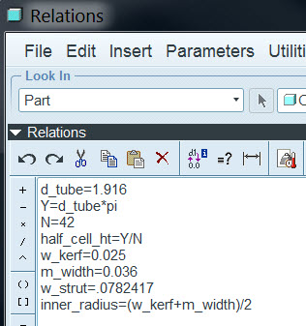
Part Relations Used
d_tube=outer diameter of stent
Y=unrolled length or height
N=number of struts around circumference
half_cell height=repeating dimension used
in creating reference datum curve
w_kerf=circumferential gap between struts
in crimped state
m_width=amount of material removal
from feature widths
w_strut=width of strut in finished state
inner_radius=inner radius of an apex
Also note Pro/E model is meant to reflect
the finished state of the stent
For a more detailed explanation of all variables please see the Open Stent Design web site at
www.nitinol.com

Slide 6
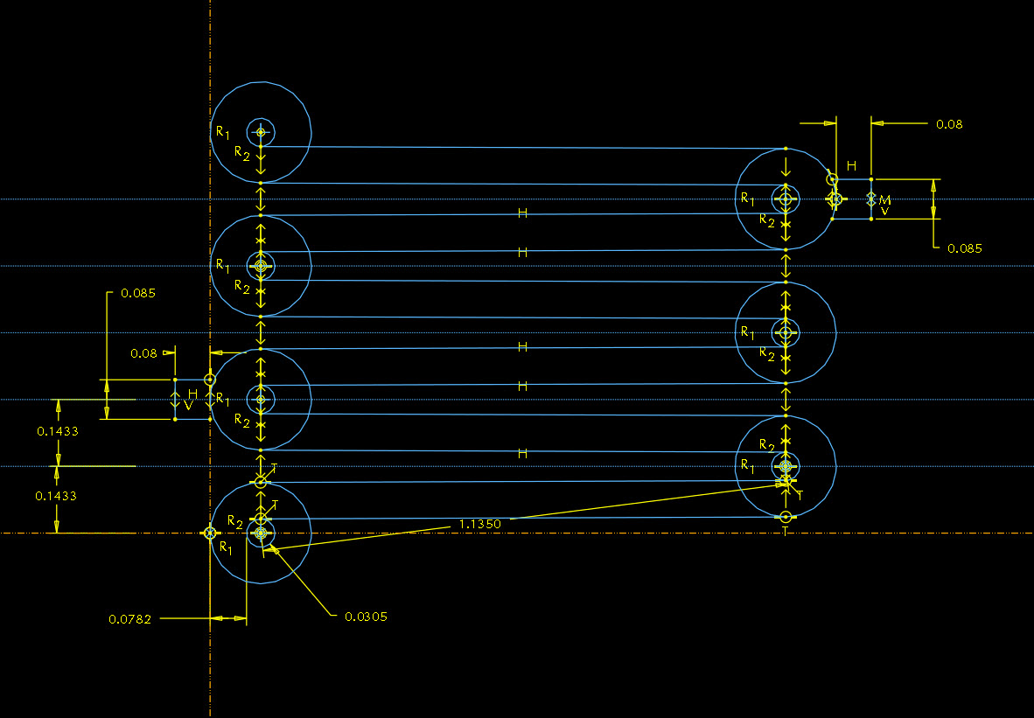
Datum Curve Sketch
A separate datum curve feature was used for simplicity. This sketch could have been used within the fill feature itself to reduce the number of features. But I just found it easier to keep track of the dimensions using a separate sketched feature. This feature was used as a reference for flat surface “filled” feature later in the model tree.

Slide 7
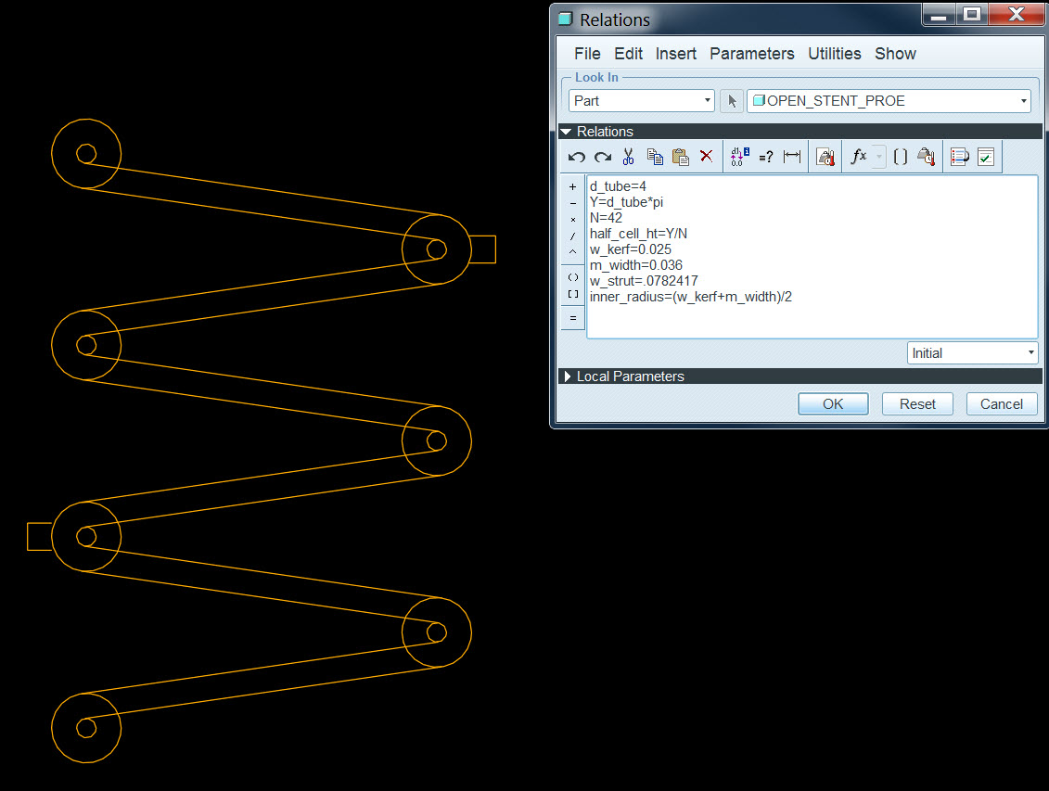
The sketched datum curve is easily “flexed” by changing the parametric value governing the diameter. The height of the sketch is related to the diameter (multiplied by Pi) and divided by the number “N”.

Slide 8
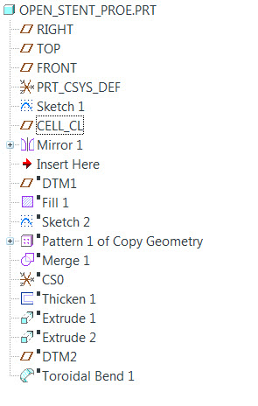
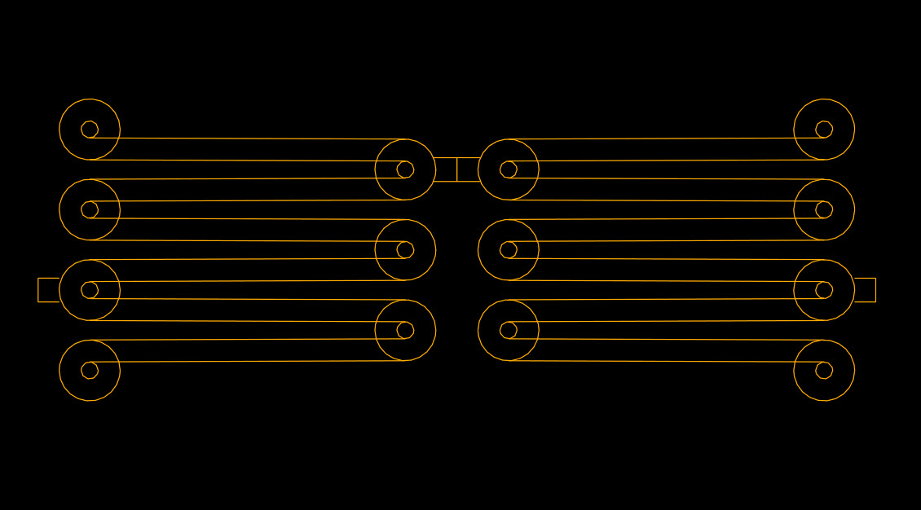
Datum curve is mirrored about datum “CELL_CL”

Slide 9
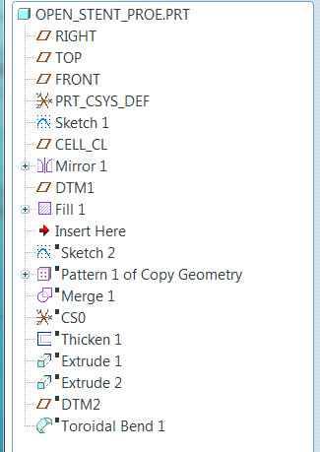
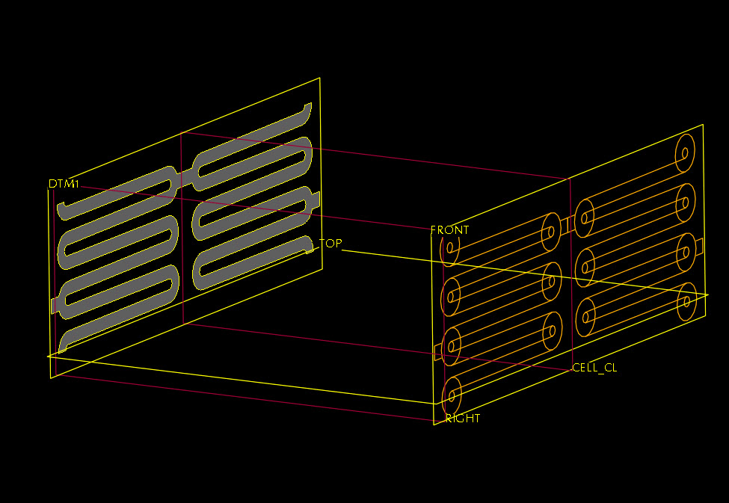
Flat surface feature created using “Edit/Fill” feature and use edge tool referencing previously constructed datum curves.
The fill feature was constructed on a separate plane for visual clarity only.

Slide 10
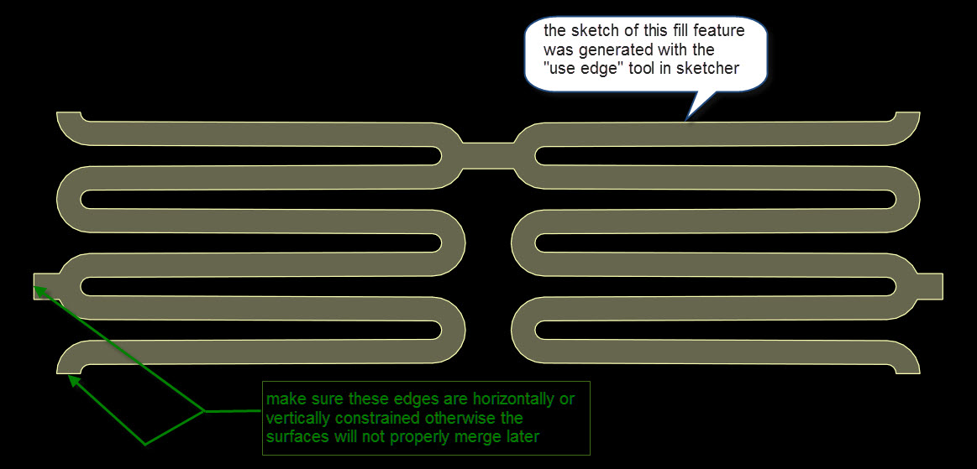

Slide 11
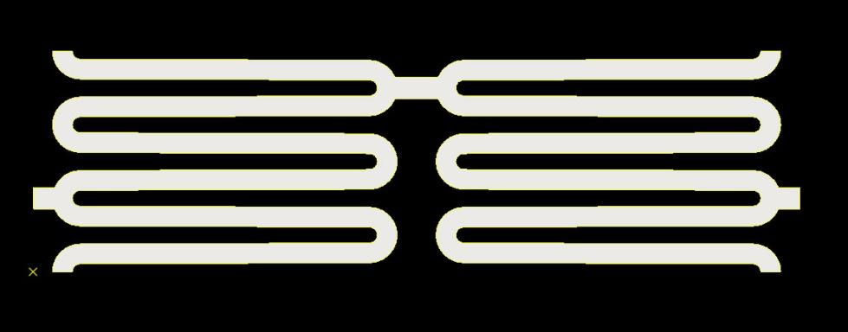
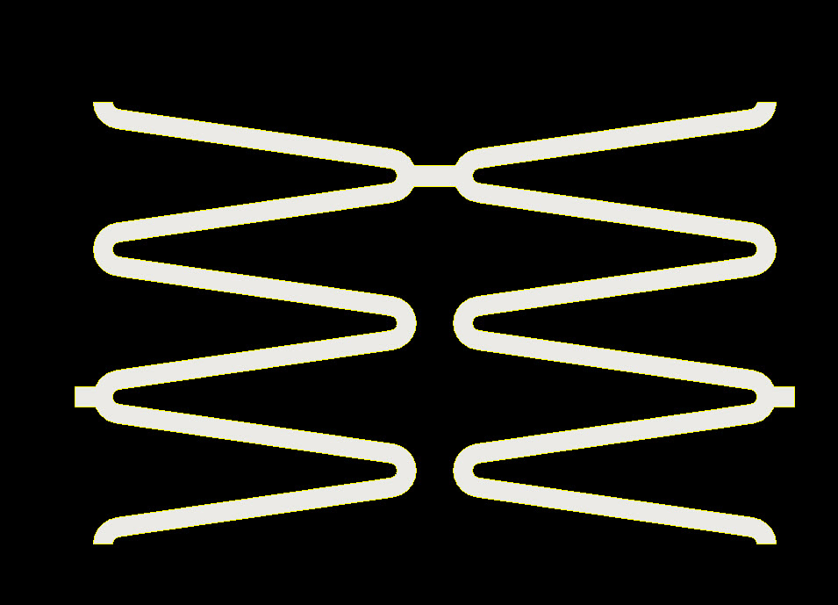
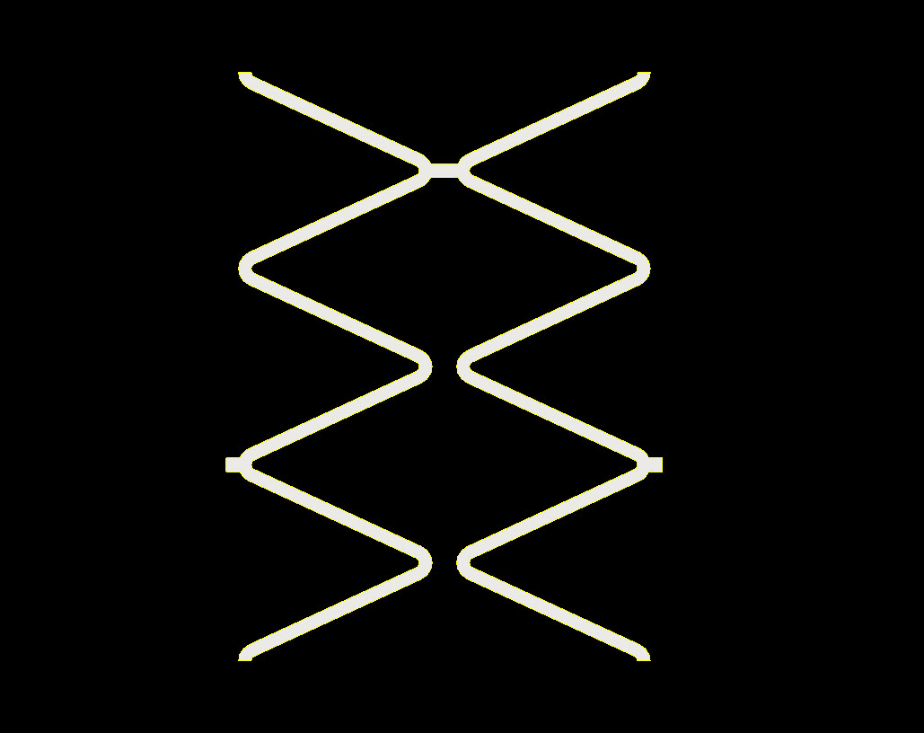
Datum surface can be flexed through a range of different values

Slide 12
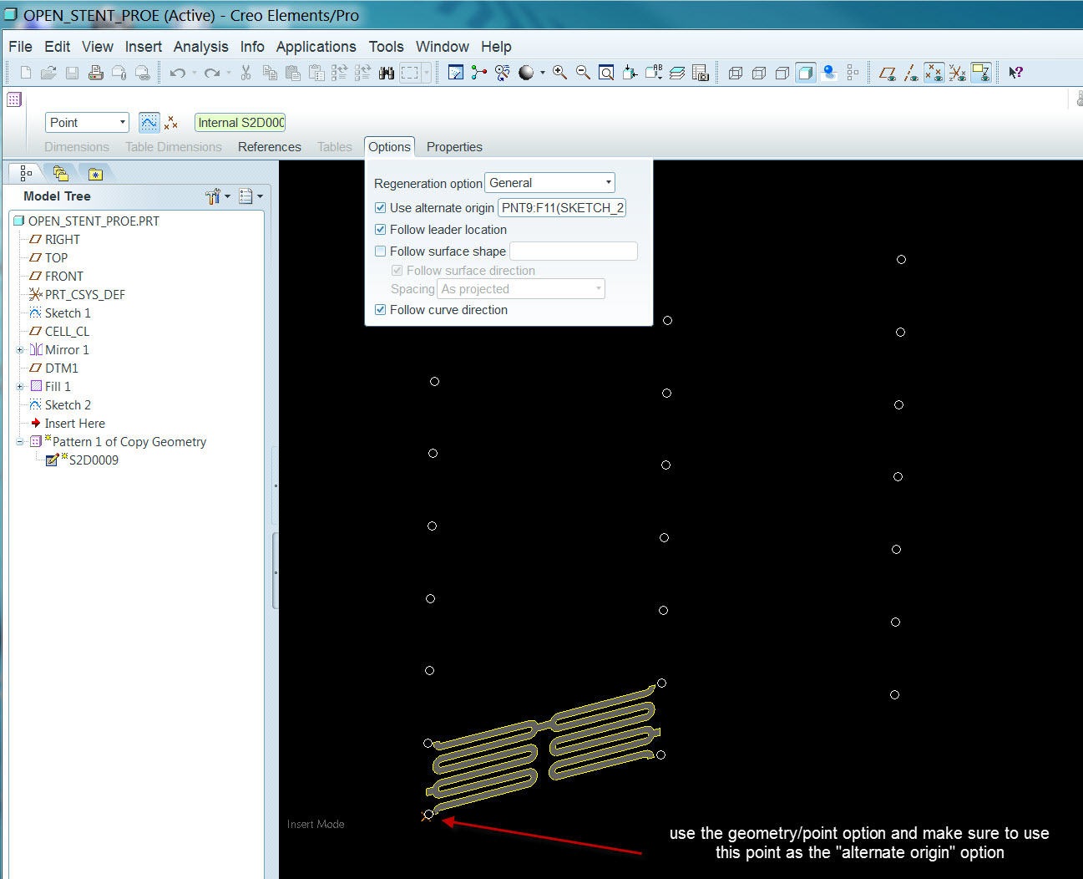
Pattern procedure
Use geometry selector and select the fill surface
Select “Edit/Geometry Pattern/Point”
Create sketch of points to use
The point pattern feature allows the length of the fill feature to update the pattern instancing without the use of a calculation or relation. There are 5 instances in the length or X direction but this can be varied depending on the number of sketched points.
There needs to be exactly 7 instances in the Y direction. This number is related to the number N and the way the unit cell was sketched.

Slide 13
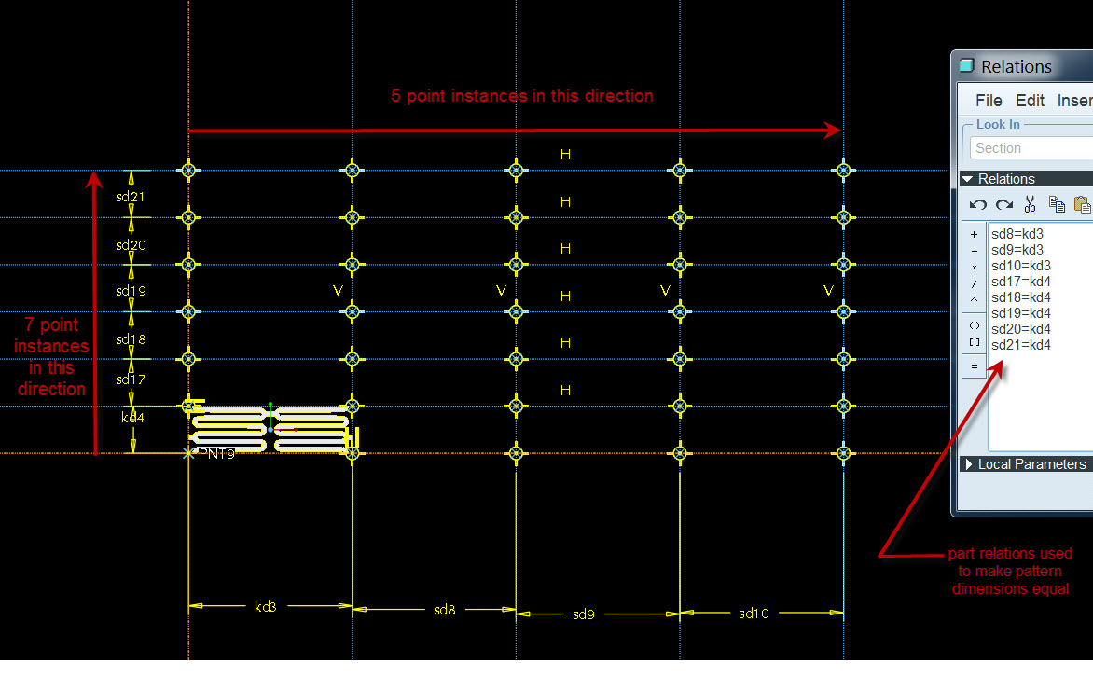
Details of sketched point pattern

Slide 14
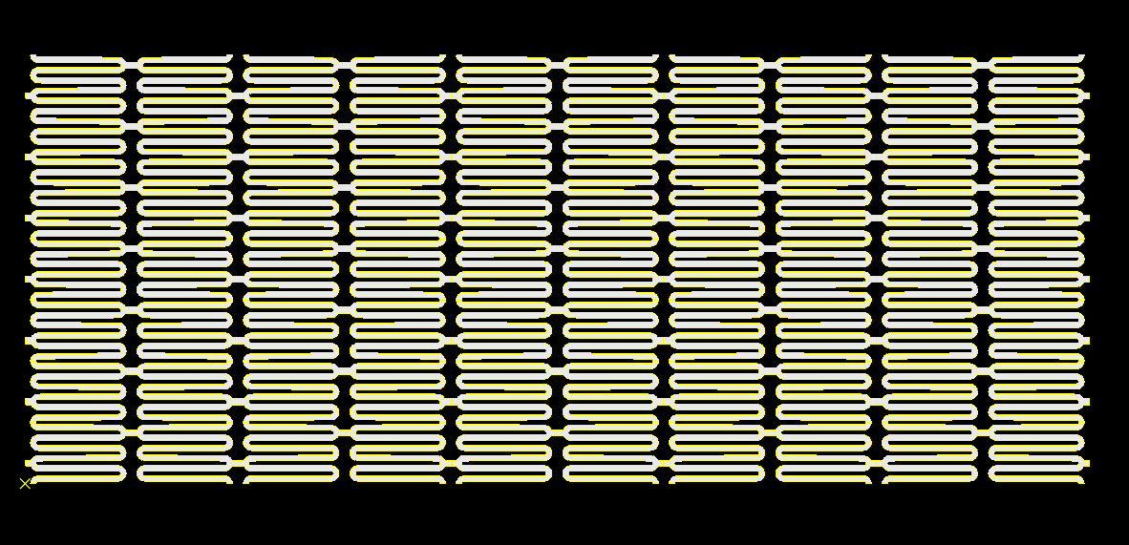
Your patterned surfaces should look like this:

Slide 15
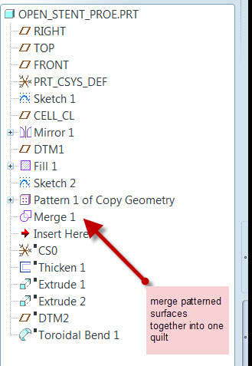
Patterning the surface geometry first speeds up regeneration time when flexing the model to different diameter values.
Merge each instance into one quilt. Now the hard work is done.

Slide 16
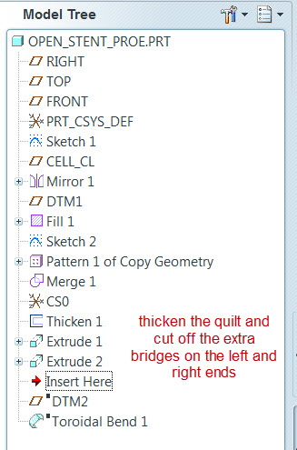
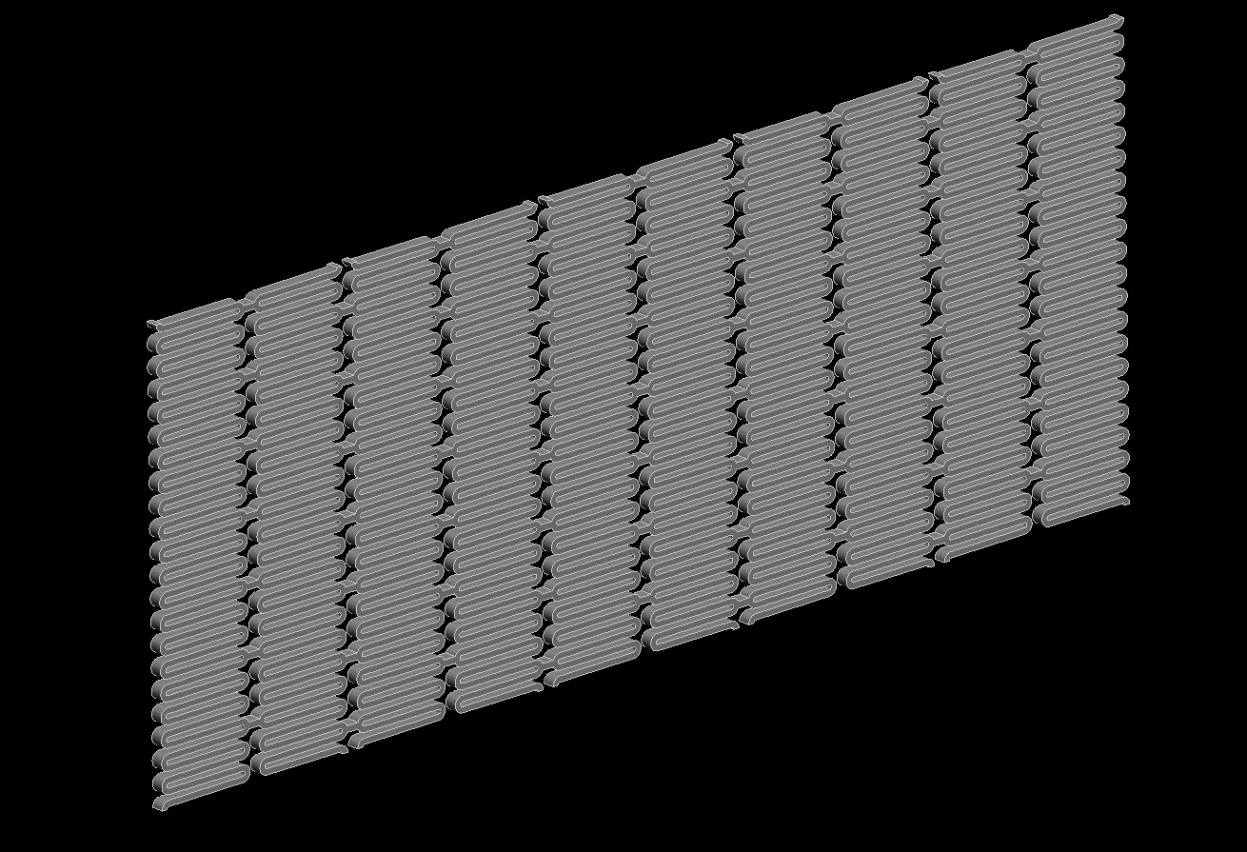
Thicken the merged quilt and use simple extrusion to cut off the ends

Slide 17
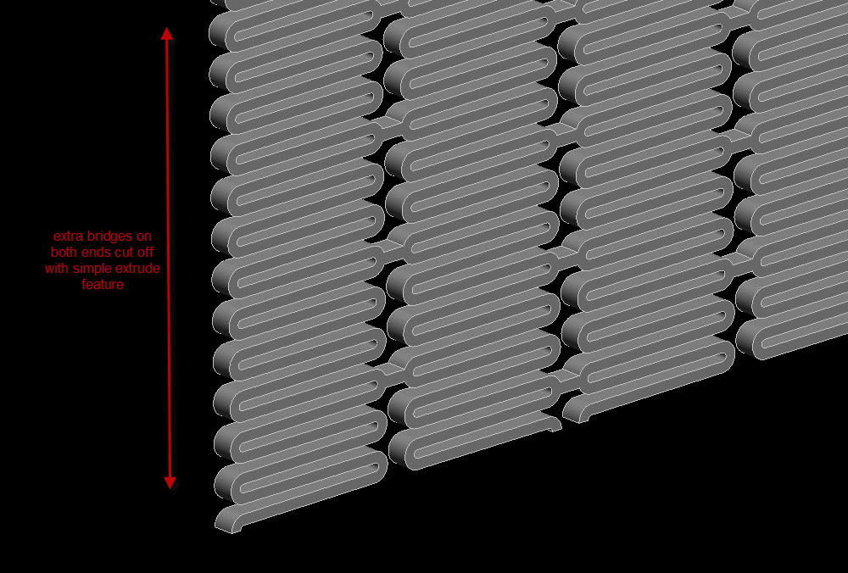

Slide 18
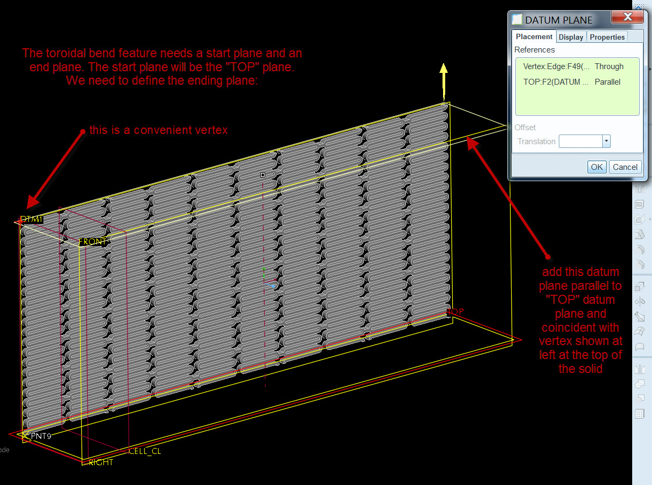
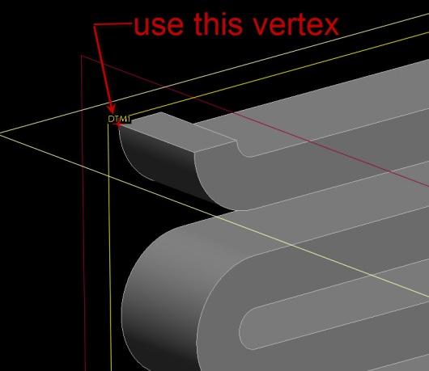
Add a datum to be used to define end of toroidal bend feature

Slide 19
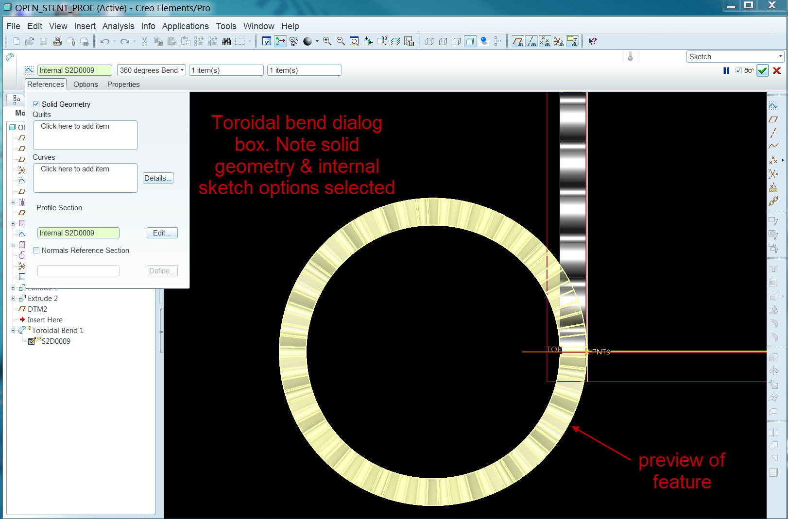
Toroidal Bend feature definition

Slide 20
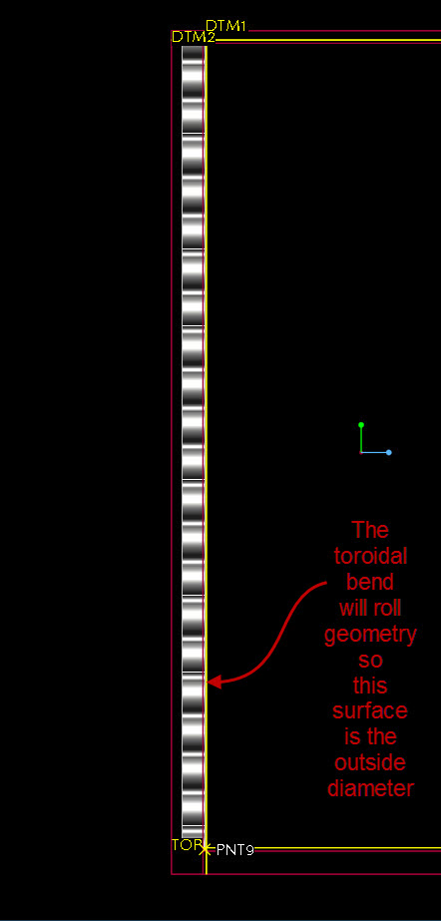
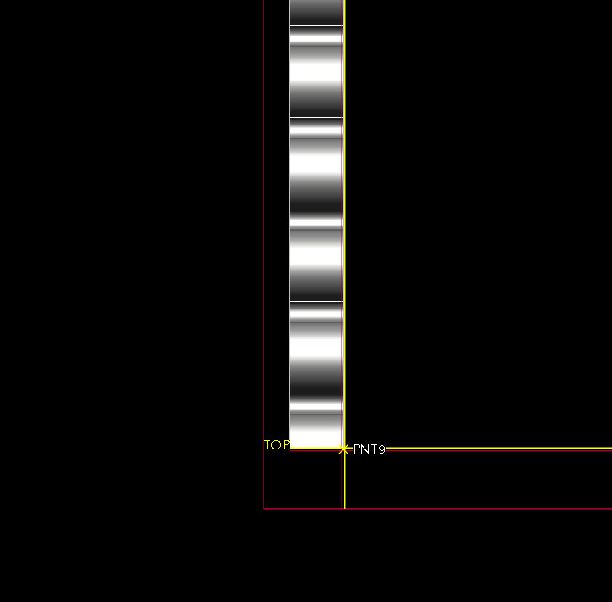
Toroidal Bend Details
This surface will
be OD

Slide 21
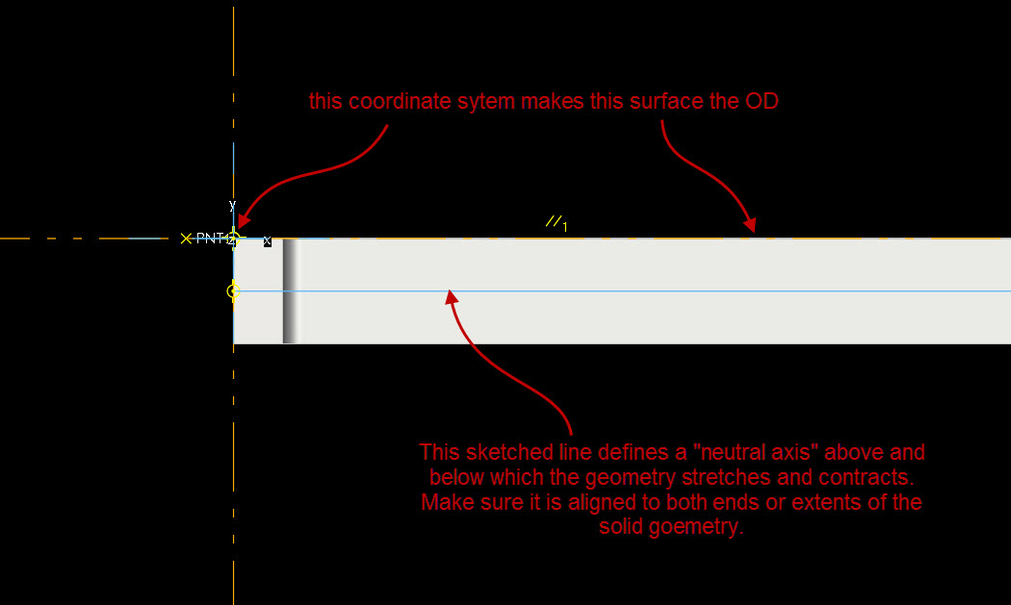
Toroidal Bend Details

Slide 22
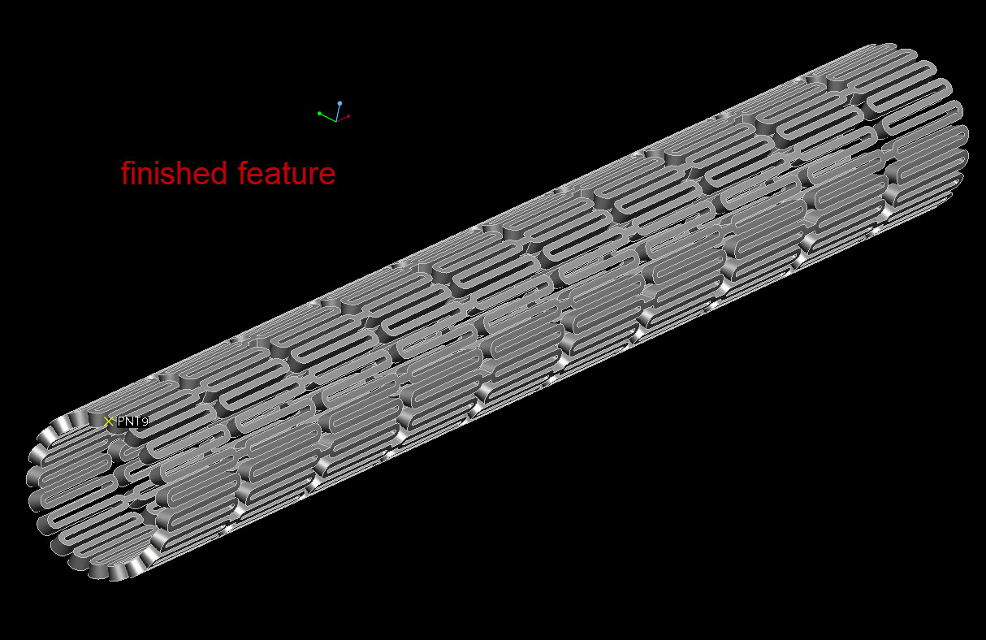
Toroidal Bend Feature Details

Slide 23
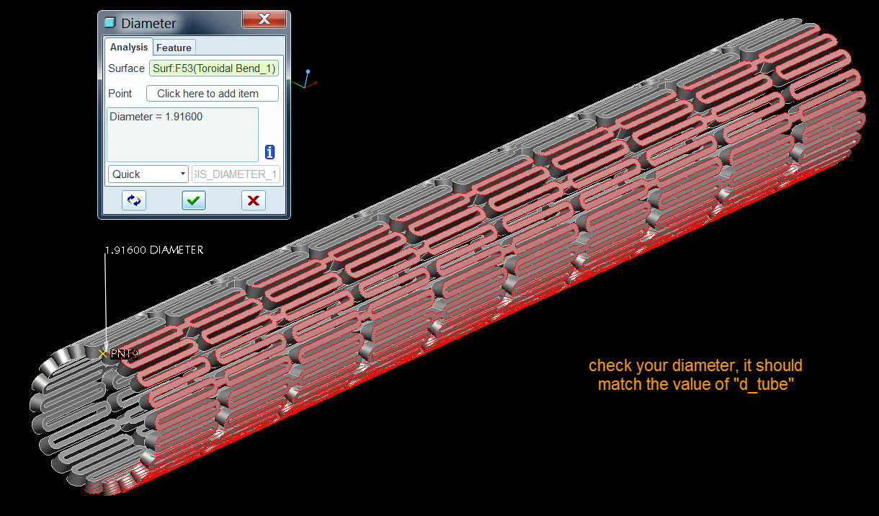
Finished Stent Geometry

Slide 24
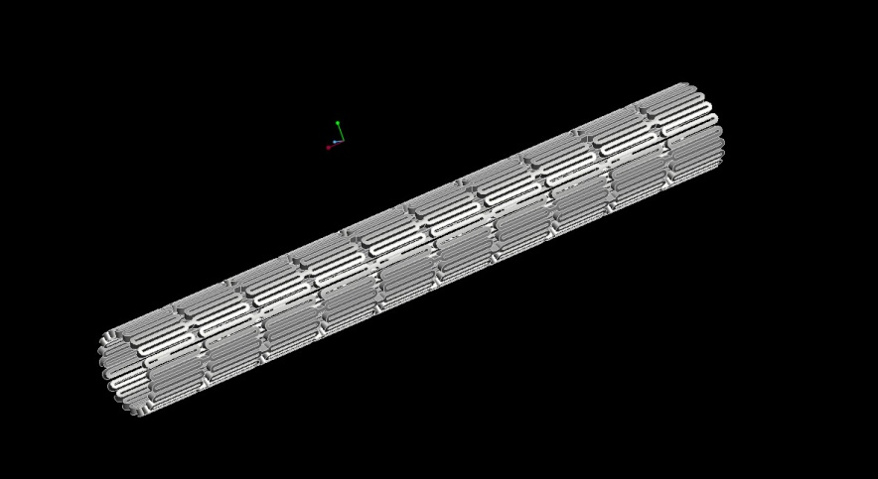
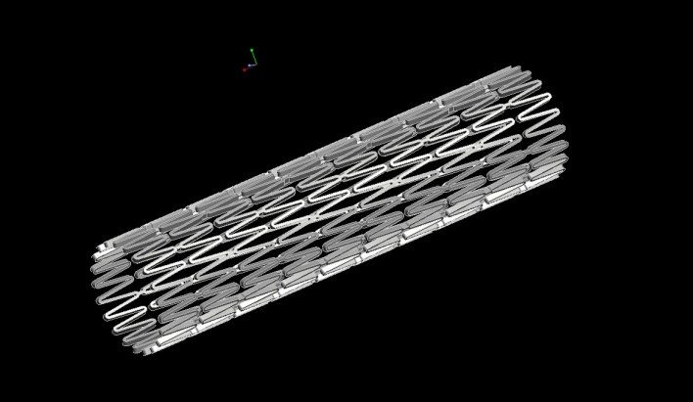
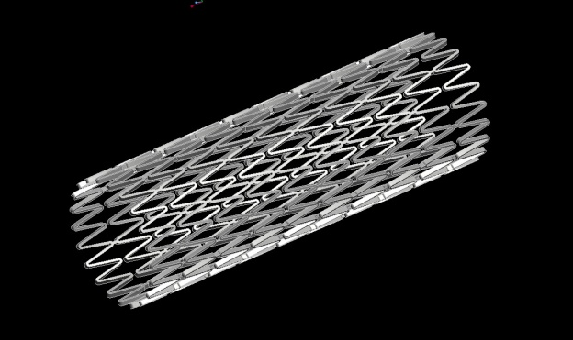
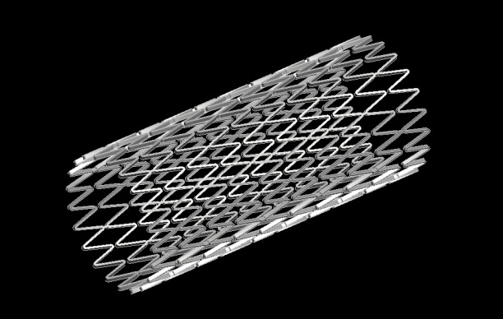
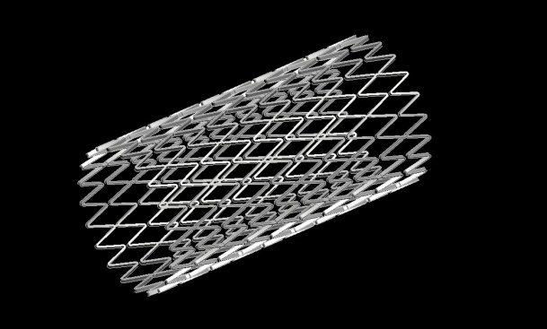
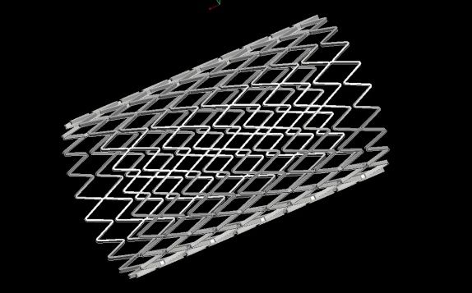
Now flex the model between any value from 1.916 to 8.00 mm
Note these pictures are for illustration only and not to any relative scale

Slide 25
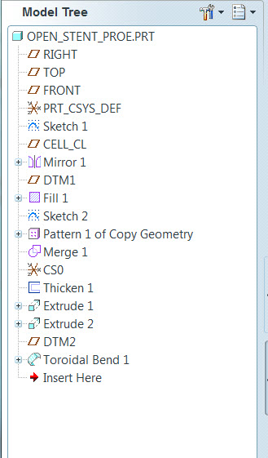
Final Model Tree
There are not a lot of features in the model tree. So once you master the sketch of the datum curve and the point pattern sketch this is actually a pretty simple model.

Slide 26
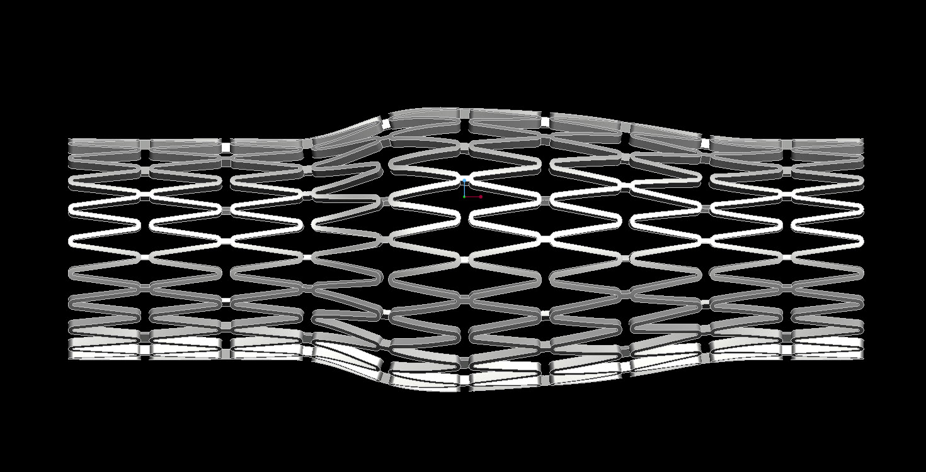
Lastly, and perhaps this is out of the realm of manufacturing possibility , but it may be interesting if, somehow, the deployed shape could be mapped onto a datum surface that would be shaped to a match particular individual’s MRI data (imported like scan data). Geometrically that could be done with a simple manipulation of the toroidal bend feature as shown below. The difficulty would be probably be in manufacturing such a deployed shape from something that works in a guide wire mechanism…it may not even be possible. But if it could be, then stents could be custom made to suit a particular individual’s or a typical aggregate arterial shape.

Slide 27
My thanks to Mr. Craig Bonsignore of NDC for providing such a wealth of information on this interesting topic in an open source format.
Please see the Open Stent Design website at:
http://www.nitinol.com/nitinol-university/open-stent-design/introducing-open-stent-design
Don’t forget the model and the configuration files are available using the following link: https://github.com/cbonsig/open-stent/
If you have any problems downloading the files you can contact me directly at my email address:
esmith@teckna3d.com
I am in the process of making a you tube type video of this process so if you want to know when that is available just drop me a line
Thanks Again to NDC and don’t forget to check out my website at
http://www.teckna3d.com

